Slide 1


RunForLife
Rupan Talwar Ankur Pandey
402408828 408067486

Slide 2
The Healthy App !
RunForLife is a health and fitness application developed for Android mobile devices
Track every bit of your run including distance, pace, calories and elevation using Google Maps ®
Quick access to details of your latest and best activity session
Intuitive, easy to use interface

Slide 3
Key Features
Google Maps®
Session Management (User login/SharedPreferences)
Online Database Management (WAMP open-source software)
mySQL/PHPmyAdmin
JSON (JavaScript Object Notation)
Android Concurrency (AsyncTask)
Settings Screen (ToggleButton)

Slide 4
The App Flow
Login
Settings
Home
User Profile
Leader Board

Slide 5
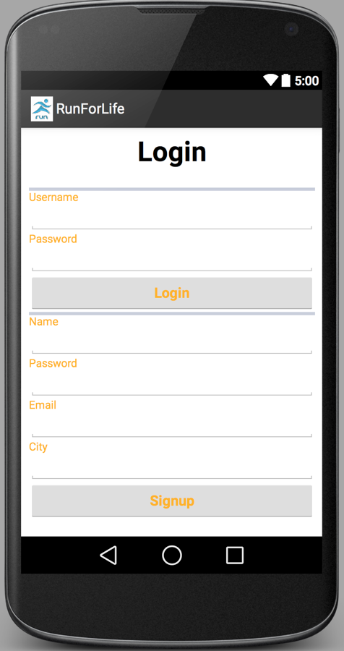

The UI - Login
New users sign up and existing users log in using email and password
Uses form field validation
No duplicate email addresses allowed
Session management
Use to logout of a session when in home screen

Slide 6

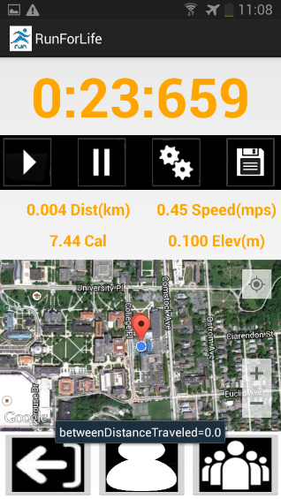



The UI - Home
Heart of the application
Click to start a session that tracks distance travelled, pace, calories burnt and elevation gained during an activity
Click to save the session
Change the metrics of distance and elevation through settings button
Real-time location tracking through Google Maps®

Slide 7
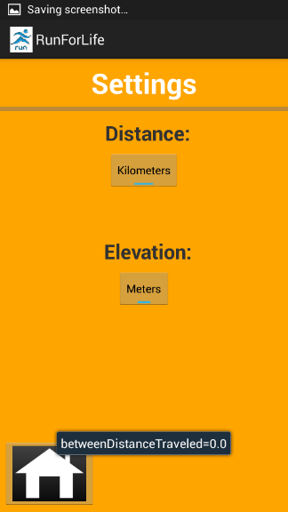
The UI - Settings
Change the metric of distance travelled from ‘kilometers’ to ‘Miles’ and elevation from ‘Meters’ to ‘Feet’
Toggle on/off button

Slide 8

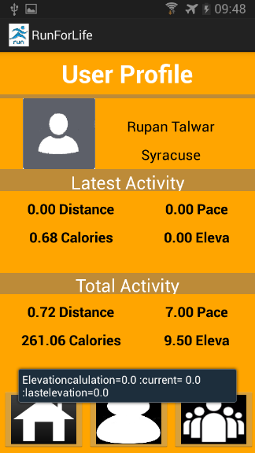
The UI – User Profile
Loads user specific data from the database
Displays the activity details from the latest activity and the total from all activities completed till date

Slide 9

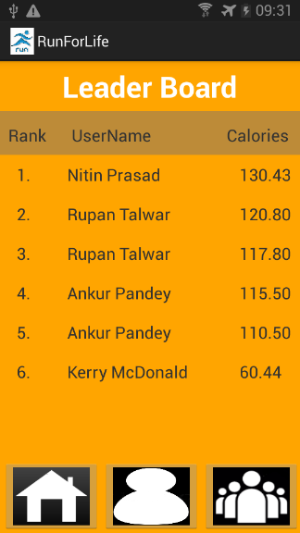
The UI – Leader Board
Ranks users as a list in descending order of the total calories burnt by them

Slide 10
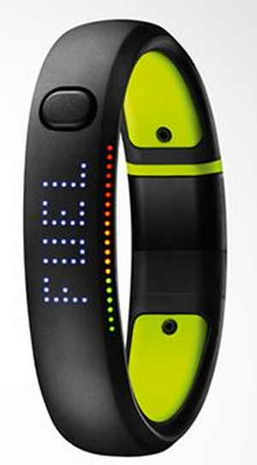
What’s next?
Integration with wearable tech like Nike+ FuelBand to monitor body statistics
Third party application support in the form of camera, social media apps, et al
Social Hiking

Slide 11
Thank You !

